Slide 1
Statistics for Analytics (BAN 100)
Assignment 3
by : Aaron Gonsalves
(161288196)

Slide 2
PROBLEM 1
HYPOTHESIS
Determining whether ownership of stocks varied by age.
Null Hypothesis(H₀): | There is no difference in mean of stock ownership between the four age groups.
Alternative Hypothesis(H_{a}): | There is a change in at least one of the four age groups regarding stock ownership.

Slide 3
CODES
data stocks; set work.stocks; run; proc print data=stocks; run;
data agecategory1;
set stocks(obs=84);
agecatg = "Young (under 35)";
stockvalue = young;
drop Young Early_Middle_Age Late_Middle_Age Senior E F G H;
run;
*proc print data=agecategory1;
*run;
data agecategory2;
set stocks(obs=131);
agecatg = "Early middle age (35 to 40)";
stockvalue = Early_Middle_Age;
drop Young Early_Middle_Age Late_Middle_Age Senior E F G H;
run;
*proc print data=agecategory2;
*run;

Slide 4
data agecategory3;
set stocks(obs=93);
agecatg = "Late middle age (50 to 65)";
stockvalue = Late_Middle_Age;
drop Young Early_Middle_Age Late_Middle_Age Senior E F G H;
run;
*proc print data=agecategory3;
*run;
data agecategory4;
set stocks(obs=58);
agecatg = "Senior (over 65)";
stockvalue = Senior;
drop Young Early_Middle_Age Late_Middle_Age Senior E F G H;
run;
*proc print data=agecategory4;
*run;
data stocksbyage;
set agecategory1 agecategory2 agecategory3 agecategory4;
run;
*proc print data=stocksbyage;
*run;
title 'Anova calculations :';
proc anova data=stocksbyage;
class agecatg;
model stockvalue = agecatg;
run;

Slide 5
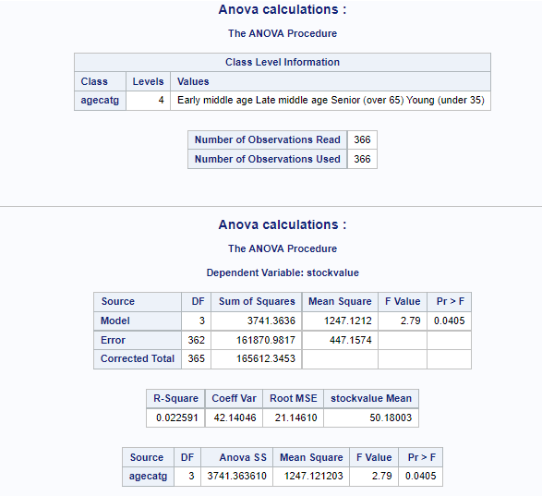
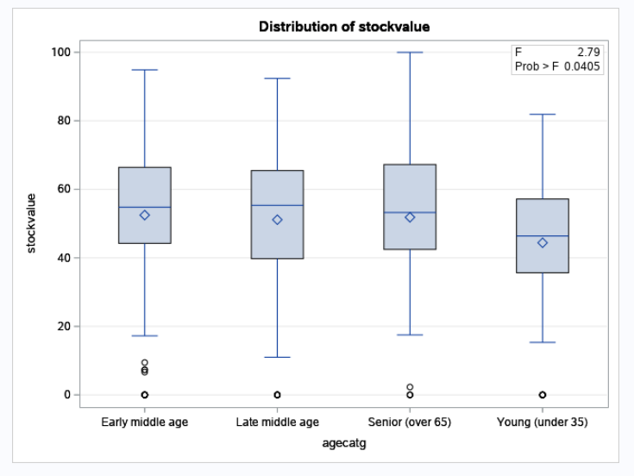

Slide 6
Interpretation
There is a 5% significance level, and P-value from Anova test is 0.0405.
As P-value<0.05, Null hypothesis (H₀) is rejected i.e. no difference between mean stock value between different age groups, and there is much evidence in support of Alternative Hypothesis(H_{a}).
Conclusion
As Null hypothesis (H₀) is rejected from our interpretation, the conclusion is in support of Alternative Hypothesis(H_{a}).
This deduces that there is a change in at least one of the four age groups regarding stock ownership.

Slide 7
CODES TO CONVERT DATA INTO PROPER FORMAT
PROBLEM 2
data jobs;
set work.jobs;
run;
proc print data=jobs;
run;

Slide 8
CODES TO CONVERT DATA INTO PROPER FORMAT
data jobs_m1;
set jobs(obs=10);
edu_level = "Less than high school (E1)";
jobs_num = Male_E1;
Gender = "Male";
drop Male_E1 Male_E2 Male_E3 Male_E4 Female_E1 Female_E2 Female_E3 Female_E4;
run;
data jobs_m2;
set jobs(obs=10);
edu_level = "High school (E2)";
jobs_num = Male_E2;
Gender = "Male";
drop Male_E1 Male_E2 Male_E3 Male_E4 Female_E1 Female_E2 Female_E3 Female_E4;
run;
data jobs_m3;
set jobs(obs=10);
edu_level = "Some college/university but not degree (E3)";
jobs_num = Male_E3;
Gender = "Male";
drop Male_E1 Male_E2 Male_E3 Male_E4 Female_E1 Female_E2 Female_E3 Female_E4;
run;
data jobs_m4;
set jobs(obs=10);
edu_level = "At least one university (E4)";
jobs_num = Male_E4;
Gender = "Male";
drop Male_E1 Male_E2 Male_E3 Male_E4 Female_E1 Female_E2 Female_E3 Female_E4;
run;

Slide 9
data jobs_f1;
set jobs(obs=10);
edu_level = "Less than high school (E1)";
jobs_num = Female_E1;
Gender = "Female";
drop Male_E1 Male_E2 Male_E3 Male_E4 Female_E1 Female_E2 Female_E3 Female_E4;
run;
data jobs_f2;
set jobs(obs=10);
edu_level = "High school (E2)";
jobs_num = Female_E2;
Gender = "Female";
drop Male_E1 Male_E2 Male_E3 Male_E4 Female_E1 Female_E2 Female_E3 Female_E4;
run;
data jobs_f3;
set jobs(obs=10);
edu_level = "Some college/university but not degree (E3)";
jobs_num = Female_E3;
Gender = "Female";
drop Male_E1 Male_E2 Male_E3 Male_E4 Female_E1 Female_E2 Female_E3 Female_E4;
run;
data jobs_f4;
set jobs(obs=10);
edu_level = "At least one university (E4)";
jobs_num = Female_E4;
Gender = "Female";
drop Male_E1 Male_E2 Male_E3 Male_E4 Female_E1 Female_E2 Female_E3 Female_E4;
run;
title 'Education by gender:';
data educationbygender;
set jobs_m1 jobs_m2 jobs_m3 jobs_m4 jobs_f1 jobs_f2 jobs_f3 jobs_f4;
proc print data=educationbygender;
run;

Slide 10
HYPOTHESIS 1
A. Test to determine whether there is interaction between gender and education
in holding jobs.
Null Hypothesis(H₀): | There is no interaction between gender and education in holding jobs.
Alternative Hypothesis(H_{a}): | There is interaction between gender and education in holding jobs.

Slide 11
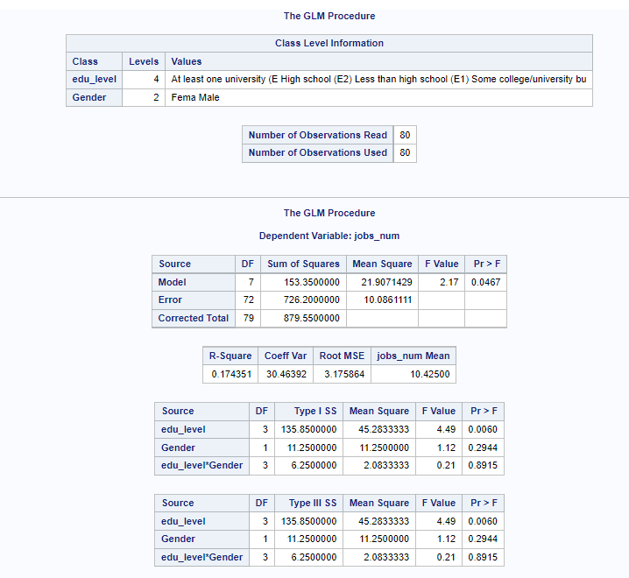
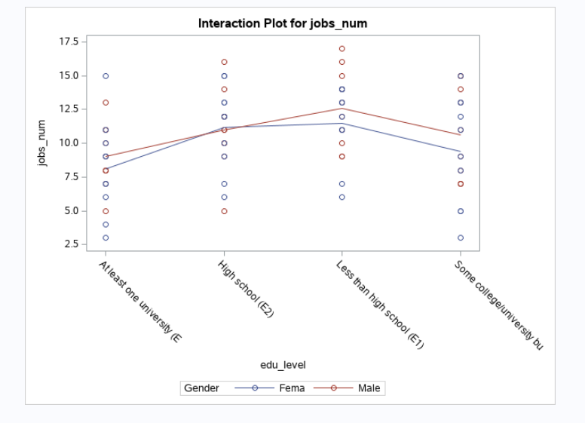
2- WAY ANOVA STATISTICS
proc glm data=educationbygender;
class edu_level Gender;
model jobs_num = edu_level | Gender;
run;

Slide 12
Interpretation
From the 4th table of the GLM procedure, we check the p value for edu_level*Gender.
The level of significance is 5%.
The p value is 0.8915, which is significant as p-value>0.05, implying that null hypothesis (H₀) should not be rejected.
Conclusion
Based on the above interpretation our conclusion is in support of Null hypothesis (H₀).
This deduces that there is no interaction between gender and education in holding jobs.

Slide 13
HYPOTHESIS 2
B. Test to determine whether there are differences in holding jobs between men
and women.
Null Hypothesis(H₀): | The means of men and women are equal in holding jobs.
Alternative Hypothesis(H_{a}): | The means of men and women are not equal in holding jobs.

Slide 14
2- WAY ANOVA STATISTICS
proc glm data=educationbygender;
class edu_level Gender;
model jobs_num = edu_level | Gender;
run;

Slide 15
Interpretation
From the 4th table of the GLM procedure, we check the p value for Gender.
The level of significance is 5%.
The p value is 0.2944, which is significant as p-value>0.05, implying that null hypothesis (H₀) should not be rejected.
Conclusion
Based on the above interpretation our conclusion is in support of Null hypothesis (H₀).
This deduces that there are no differences in holding jobs between men and women as gender does not matter.

Slide 16
HYPOTHESIS 3
C. Test to determine whether there are differences in holding jobs between the
educational levels.
Null Hypothesis(H₀): | The means of different educational levels are equal in holding jobs.
Alternative Hypothesis(H_{a}): | The mean of at least one educational level is different in holding jobs.

Slide 17
2- WAY ANOVA STATISTICS
proc glm data=educationbygender;
class edu_level Gender;
model jobs_num = edu_level | Gender;
run;

Slide 18
Interpretation
From the 4th table of the GLM procedure, we check the p value for edu_level.
The level of significance is 5%.
The p value is 0.0060, which is not significant as p-value<0.05, implying that null hypothesis (H₀) should be rejected.
Alternative hypothesis should be considered.
Conclusion
Based on the above interpretation our conclusion is in support of alternative hypothesis (H_{a}).
This deduces that there are differences in holding jobs between the education levels.

Slide 19
THANK YOU

